Slide 1

Angular 4
Angular 4
Amit Debadwar
amit.debadwar@xoriant.com
9096 174 175
Notes:
Import { Component } from “@angular/core”;
Template Variable
$event.target.value
#email => email.value
[value]=“email” ------ one way binding Component to View
[value]=“email” ------ (change)=“email = $event.target.value; onKeyup()”

Slide 2
Session 1 Agenda
Introduction
Setting up development environment
TypeScript
Angular Building Blocks
New angular application with CLI
Discussion of some important files like package.json, .angular-cli.json, tsConfig.json

Slide 3
Introduction
What is Angular
Why Angular
To maintain properly structure of the large scale application
To implement JavaScript prototype pattern easily with minimum lines of code to access the HTML elements
Vanilla JavaScript is hard to test (Unit testing)
Notes:
Clean and loosely coupled structure
Easy to maintain
Can develop reusable code
developer have more control over the code

Slide 4
Setting up Development Environment
Visual Studio Code
Node (npm)
Angular CLI
npm install –g @angular/cli@4
ng --version

Slide 5
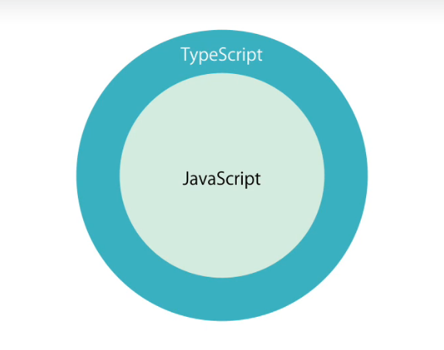
TypeScript

Slide 6
TypeScript
Strong typing
Object Oriented Features
Classes, interfaces, constructor, access modifiers, fields, properties, generics ….
Compile time errors (still not all kings of errors)
Intellisense
Notes:
npm install –g typescript
tsc --version

Slide 7
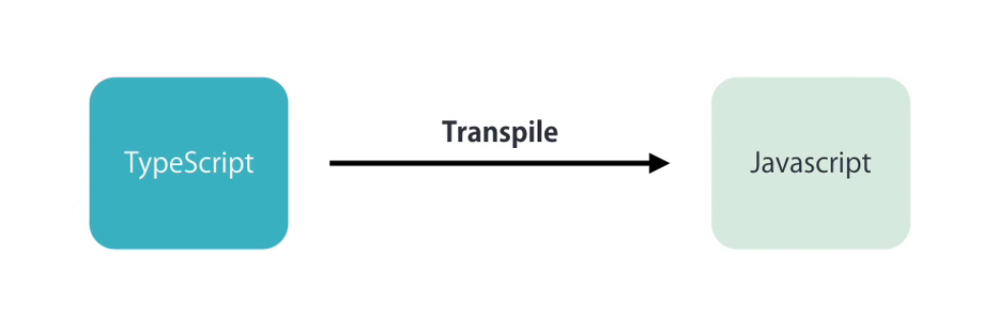
TypeScript

Slide 8
TypeScript (Types)
number
boolean
string
any
number[]
any[]
enum Color { }

Slide 9
Session 2 Agenda
Yesterdays discussion
Angular Building Blocks
New angular application with CLI
Structure of Angular project.
Discussion of some important files like package.json, .angular-cli.json, tsconfig.json

Slide 10
Angular Building Blocks
component
Templates
Directives
Services

Slide 11
New Angular Project
ng new <ApplicationName>
ng serve
Project Structure
E2E Unit Testing
node_modules
src
package.json | angular.cli.json | karma.conf.js | tsconfig.json
Notes:
Bundled js
Assets for static assets
Configurations settins according to environment

Slide 12
Component

Slide 13
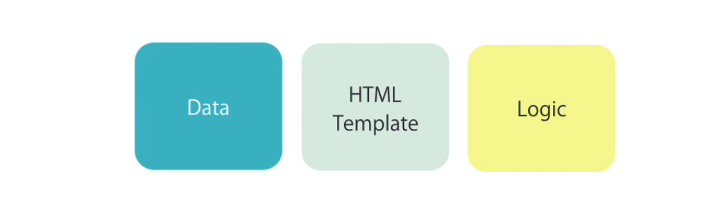
Component

Slide 14
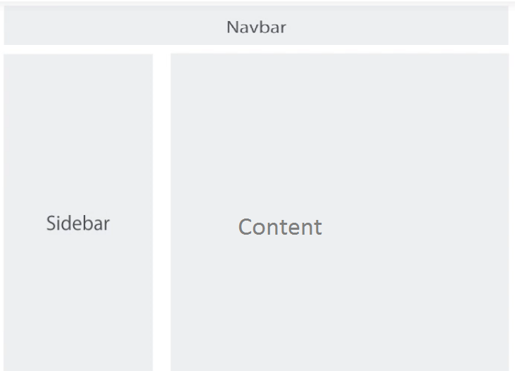
Web app layout

Slide 15
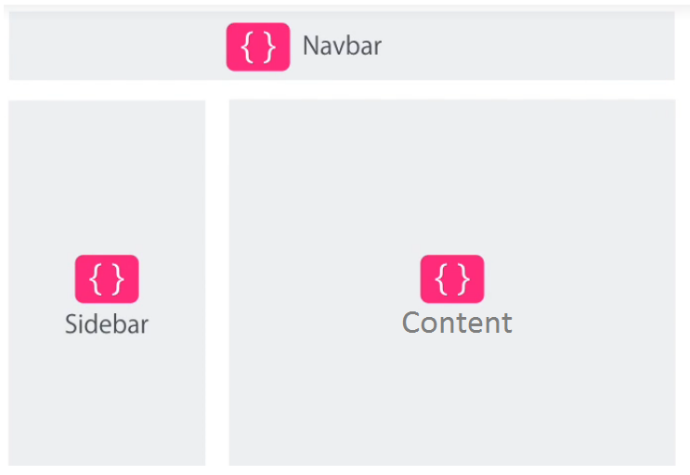

Slide 16
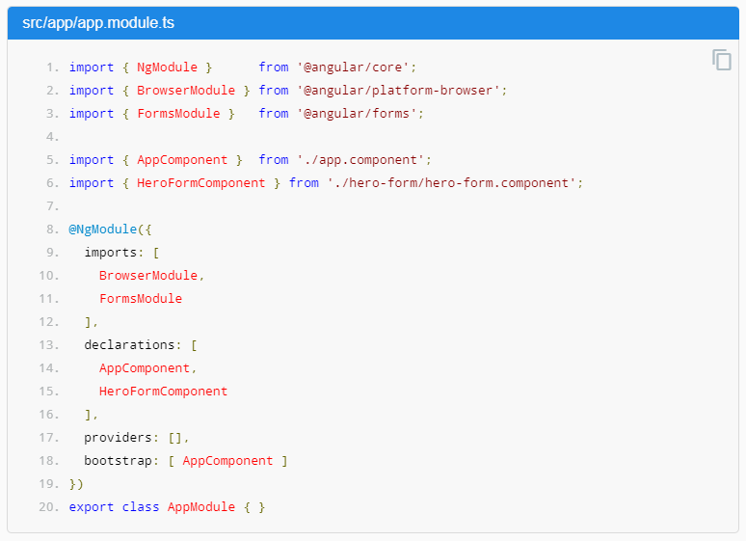
app.module.ts

Slide 17
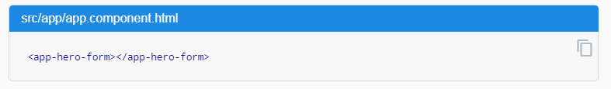
Html markup of Component

Slide 18
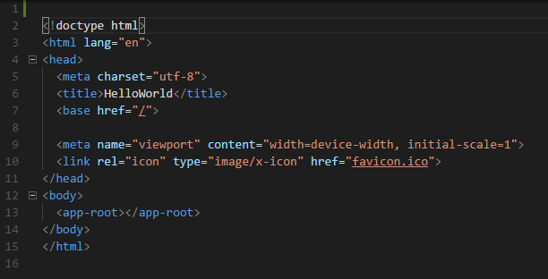
index.html

Slide 19
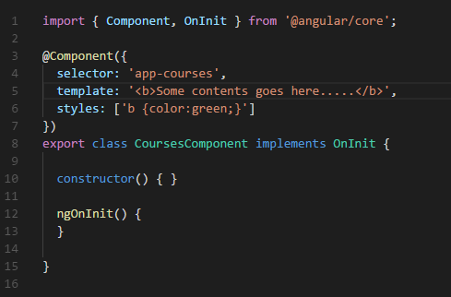
Component Code

Slide 20
Creating Component
Create a component
Register it in a module
Add an element in HTML markup
Naming convention : user-creation.component.ts
ng g c <Name Of the Component>

Slide 21
Data Binding with Inbuilt Directives
Notes:
Property binding
Attribute binding
Adding bootstrap
Class binding
Event binding
Event filtering
Template variables

Slide 22
Handling Event
<button (click)=“onSave($event)”/>
$event is the reference to the html element
EventBubbling (child to parent)
$event.stopPropagation();

Slide 23
Event Filtering
<input (keyup)=“onKeyUp($event)”/>
$event.keyCode==13
<input (keyup.enter)=“onKeyUp()”/>

Slide 24
Property Binding
String interpolation | one way binding
E.g. [hidden], [src], [textContent]
<img src=“{{ }}”></img>
<img [src]=“path”/>
Notes:
{{ }} – interpolation

Slide 25
Attribute Class Binding
td [colspan]=“value”
[attr.colspan]=“”
[class.active]=“expression”
[style.backgroundColor]=“expression”
(DOM style object properties) – google search
Notes:
Error since it is a known property of TD
HTML 1 to 1 mapping to DOM

Slide 26
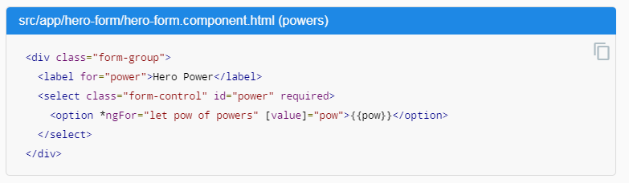
*ngFor Select Binding

Slide 27
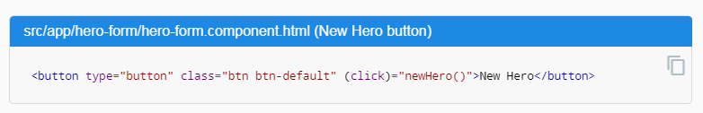
(click) Event Binding to Button

Slide 28
Recap
Building blocks
Dev Env Setup
New application
Entry point
Data binding (one/two way, interpolation)
Built in directives
Template variables

Slide 29
Session 4 Agenda
Yesterdays discussion
Adding Bootsrap 4
Routing
Pipe
Directives

Slide 30
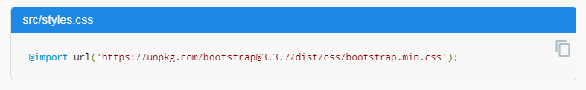
Adding Bootstrap
1) npm install bootstrap --save
2) @import “~bootstrap/dist/css/bootstrap.css”;
3) "../node_modules/jquery/dist/jquery.js",
4)"../node_modules/bootstrap/dist/js/bootstrap.js"

Slide 31
Displaying Data and Handling Events

Slide 32
Template Variable
$event.target.value
<input #email (keyup.enter)=“onKeyUp(email.value)”/>

Slide 33
Two way binding
<input [value]=“email” (keyup.enter)=“email= $event.target.value; onKeyUp();”/>
[(ngModel)]=“field”
Needs to be imported : import { FormsModule } from “@angular/forms”;

Slide 34
Routing and Navigation
Configuring routes
Implementing Single Page application
Working with Route and parameters
Programmatic navigation

Slide 35
Routing

Slide 36
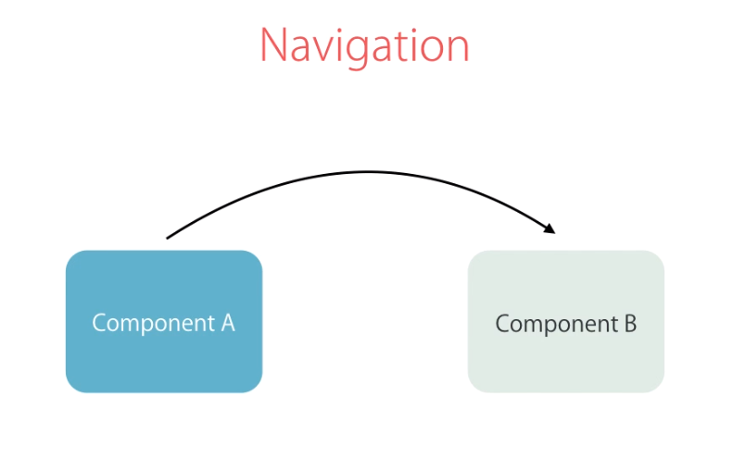
Navigation

Slide 37
Router Configuration
Implementing SPA
Configure the routes
Router outlet
Add links
Working with route and query parameters
Programmatic navigation
Notes:
import { ActivatedRoute } from '@angular/router';
import { combineLatest } from 'rxjs/observable/combineLatest';
RouterModule.forRoot()
None of the route should start with the leading /
routerLink="/posts"
[routerLink]="['/followers/',p.id]"
routerLinkActive =“classes seperated by space”
[queryParams]="{page : p.id, order: 'asc'}"
constructor(private route : ActivatedRoute) { }
this.route.paramMap.subscribe(params => {
let id = +params.get("id");
console.log(id);
});

Slide 38
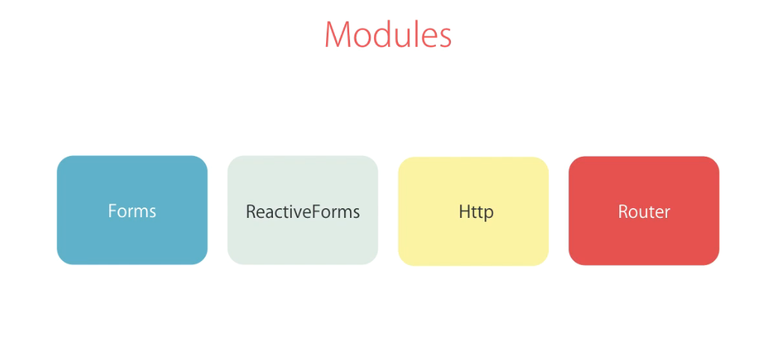
Modules
Notes:
Module contains bunch of services, reusable components and directives

Slide 39
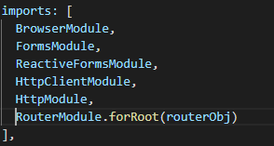

Slide 40
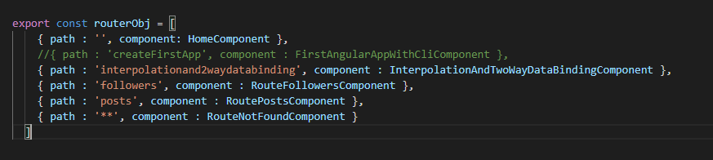
Router Object

Slide 41
Router imp directives
Not to use href=“#”
routerLink=“/users”
[routerLink]=“[‘/user’, id ]”
routerLinkActive=“class1 class2”

Slide 42
Get Route Parameters
route:ActivatedRoute
this.route.snapshot.ParamMap.get(“ “)
this.route.ParamMap.subscribe(function(param){ });
[queryParams]=“{sortOrder: ‘ASC’, page: ‘6’}”

Slide 43
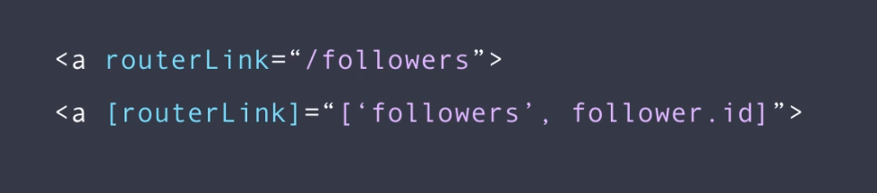
Router Link

Slide 44
Session 5 Agenda
Recap
From Types in Angular
Template Driven Forms
Reactive Froms
Validation of html element

Slide 45
Forms with UI Validation

Slide 46
Forms
For each element of the form we need to create instance of the “FormControl”
Form Group

Slide 47
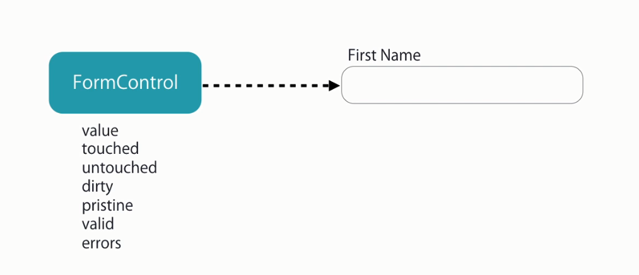
Form Control
Notes:
S7 L75 T 0:37 & 0:45 & 1:58 & 3:15

Slide 48
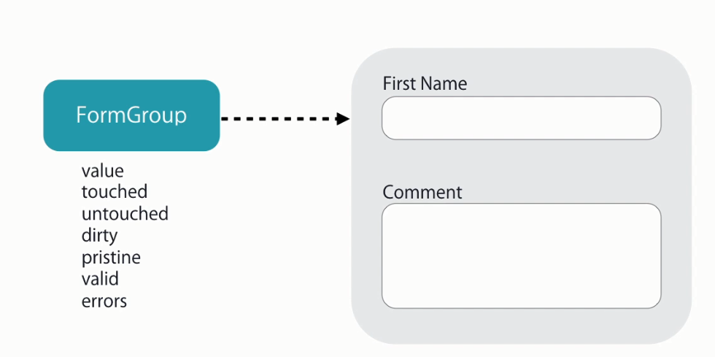
Form Group

Slide 49
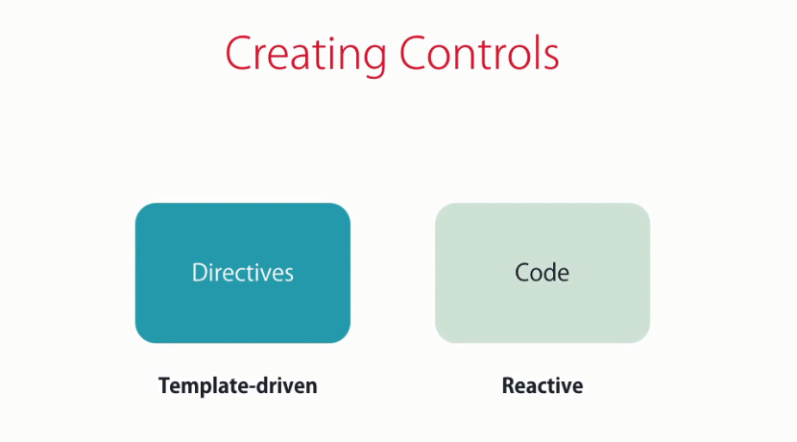
Creating Form Control

Slide 50
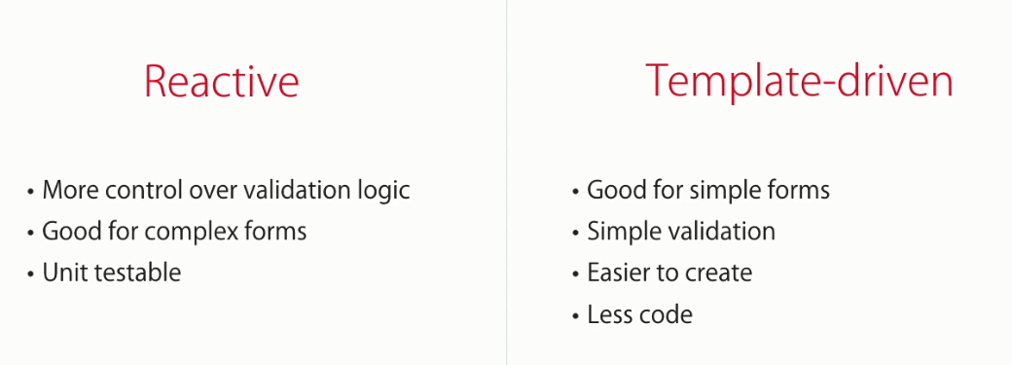
Difference Between Reactive and Template Driven form
Notes:
Implement custom validations
Implement asynchronous validation

Slide 51
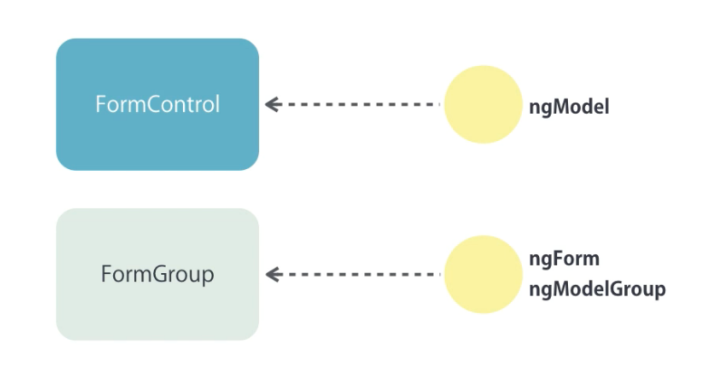
Template Driven Form

Slide 52
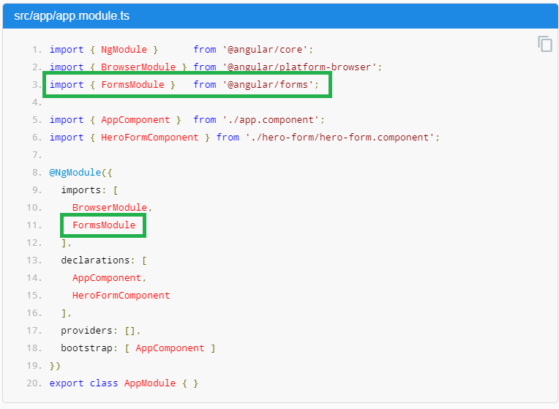
Template Driven Form
Notes:
Template driven forms only requires ngModel and name to element

Slide 53
In build Validators
Required
minlength
maxlength
pattern

Slide 54
Styling invalid input field
ng-invalid
ng-dirty
ng-touched

Slide 55
ngModelGroup
#contact = “ngModelGroup”

Slide 56
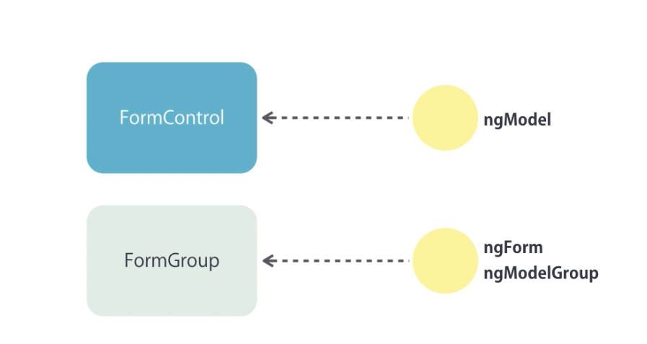
What we leanred

Slide 57
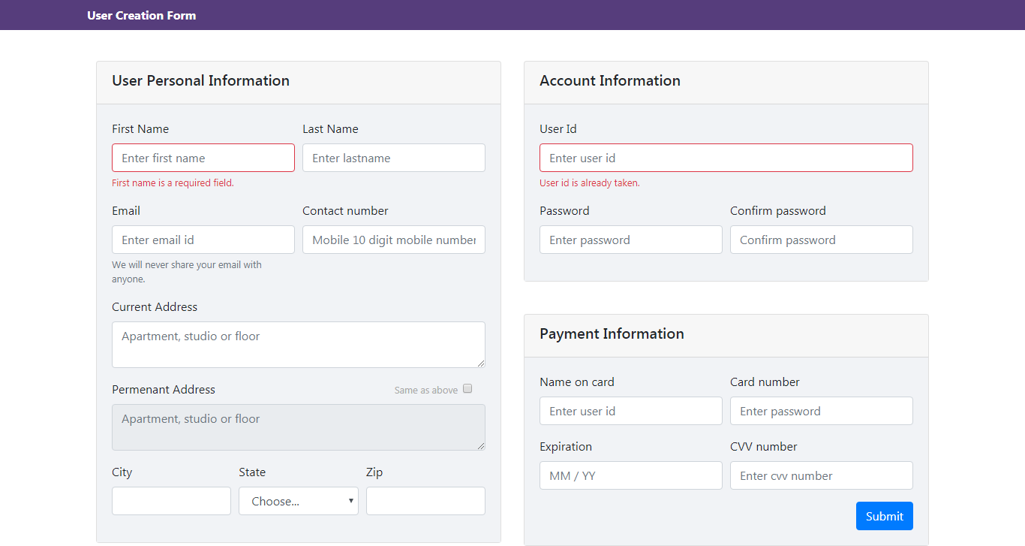
Assignment 1

Slide 58
Consuming HTTP Services

Slide 59
Agenda for Session
Perform CRUD operations
Read, create, update and delete
Extract a reusable data service
Property handle different types of errors
Build application with proper separation of concern
Json place holder
Acts like a real REST services, but data is not persistent

Slide 60
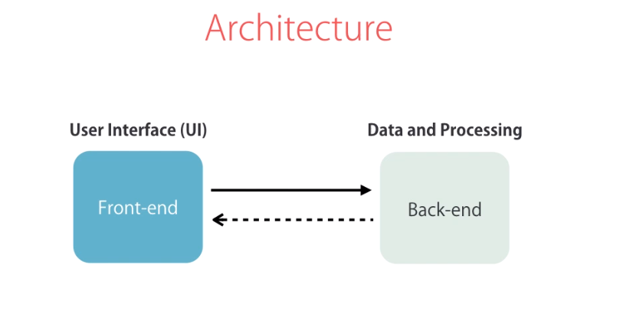
UI to Backend communication

Slide 61
JsonPlaceHolder url
jsonplaceholder.typecode.com

Slide 62
HTTP Client Module
Importing HttpClientModule
Registering HttpClientModule
Imorting HttpClient class
import { HttpClientModule} from '@angular/common/http';
import { HttpClient } from '@angular/common/http’;

Slide 63
Services

Slide 64
Creating a Service
ng g s MyService.service
Separate data fetching logic
Decoupled classes
Creating an architecture easy for Unit Testing
Needs to be registered in app.module.ts in providers array.
Notes:
Import { Injectable } from ‘@angular/core’;
@Injectable();

Slide 65
Error Handling

Slide 66
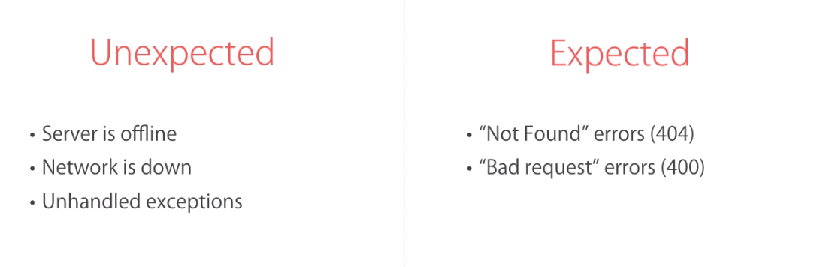
Types of Errors
Notes:
Handling unexpecred errors:
Error callback function in subscribe method as a second parameter
Handling expected error Throwing application specific errors
service will raise application specific error
components subscribe method’s error will be dealt with AppError
import { throwError } from 'rxjs’;
import { catchError } from 'rxjs/operators';

Slide 67
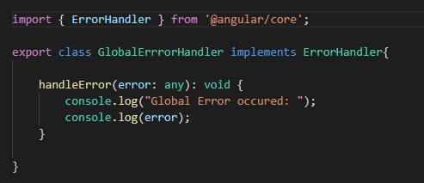
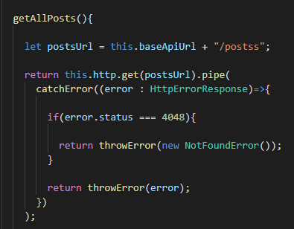

Global Error Handling
Notes:
Service pipe-> catchError -> throwError with error obj or app specific error->
Component-> check type of error else throw err

Slide 68
Pipes | Filter

Slide 69
In built Pipes
uppercase
lowercase
number
currency
date
slice

Slide 70
Creating a custom Pipe
ng g p NameOfPipe

Slide 71
Directives

Slide 72
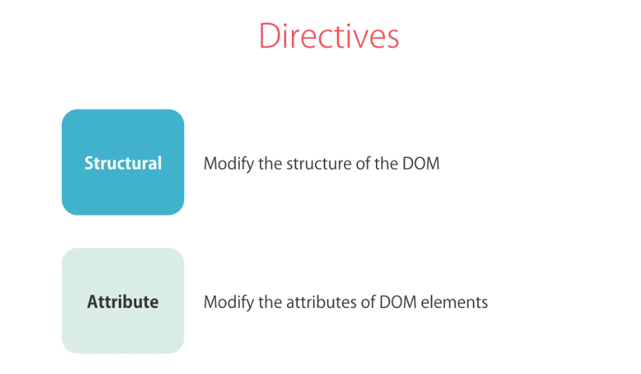
Directives Type
Notes:
IMG section 6 lecture 62 T 1:23

Slide 73
Directives
Structural Directives
Modifying a structure of a DOM
Attribute Directives
[hidden]
*ngIf
*ngFor
ngClass
ngSwitchCase
ngStyle
Notes:
<ng-template [ngIf]="hero"> <div class="name">{{hero.name}}</div> </ng-template>
<div *ngFor="let hero of heroes; let i=index; let odd=odd; trackBy: trackById" [class.odd]="odd"> ({{i}}) {{hero.name}} </div>
ElementRef
@HostListener('focus')
onFocus(){
//console.log("got the focus");
}
let value:string=this.el.nativeElement.value;
this.el.nativeElement.value="123";

Slide 74
Creating Custom Directive
ng g d [NameOfDirective]

Slide 75
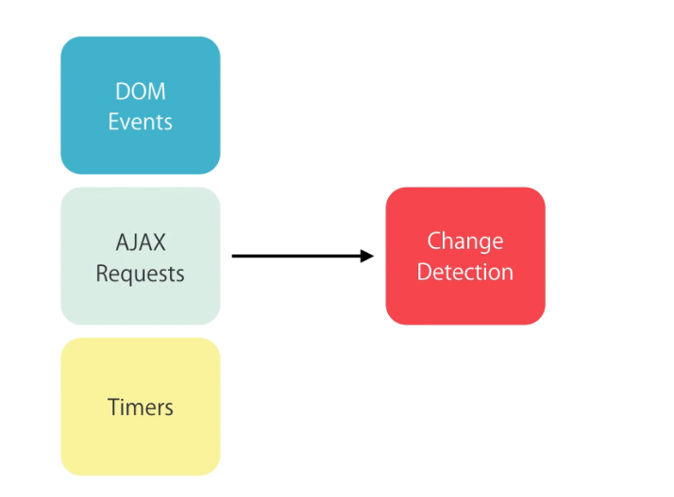
Change Detection Technique
Notes:
S6 L66 T 1:00

Slide 76
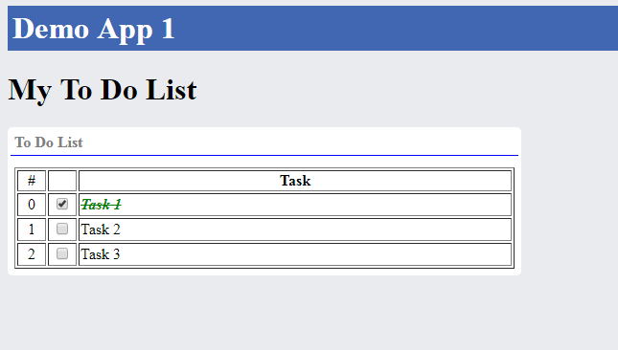
Demo App 1

Slide 77
Building Reusable Components

Slide 78
Reusable Component
Passing data
Raise custom events
Apply styles
Shadow DOM
View Encapsulation
Notes:
<favorite [isFavorite]=“expression”> </favorite> ---- cant be used
<ng-content select=“.myclass”></ng-content>
<bootstrap-panel>
<div class=“myclass”>some heading</div>
</bootstrap-panel>

Slide 79
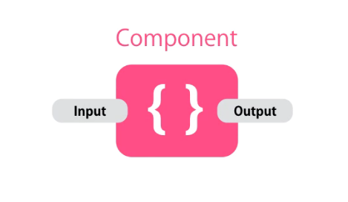
Input and Output properties

Slide 80
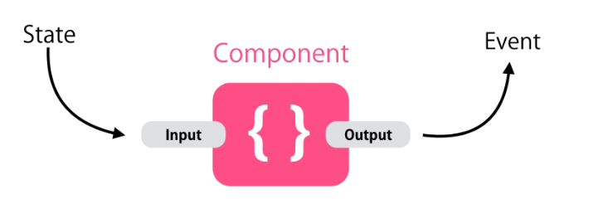
Component API
Notes:
{ Input } from “@angular/core”;

Slide 81
Input and Output Properties
Input and Output properties in 2 ways
Is providing with array
With @Input annotation
Which one to use and why?
Aliasing Input and Output properties

Slide 82
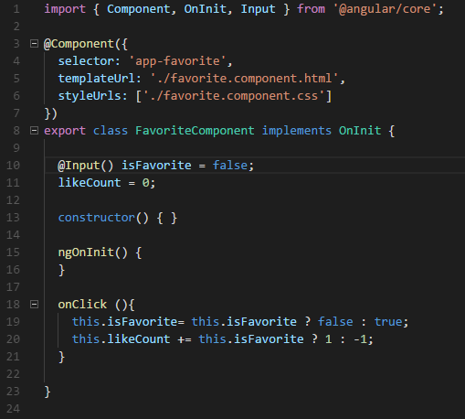
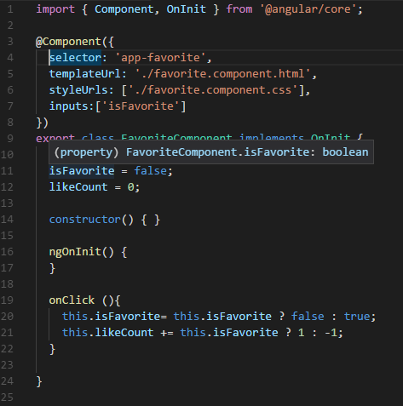
Reusable Component

Slide 83
View Encapsulation or Shadow DOM
Shadow DOM enables DOM tree and styles encapsulation.
It allows us to apply scoped styles to elements without exposing to global/outer world.
Notes:
el.createShadowRoot();
root.innerHTML =“”;

Slide 84
What is not covered
Unit testing
Debugging with Visual Studio Code
Exception handling
Extracting a data service

Slide 85
Final Test Project
What do you want? Objective test or practicle implementation?
When?

Slide 86
Practical Test Application
Routing
Event binding and filtering
Http communication with backend.
Use of Structural and Behavioural in built directives.
Creating services and Models
1 Custom directive and 1 custom pipe
1 Reusable compnent

Slide 87
Unit Testing

Slide 88
Session
Introduction to automated testing
Benefits, when and why to use it
Different types of tests
How to write tests
Code coverage

Slide 89
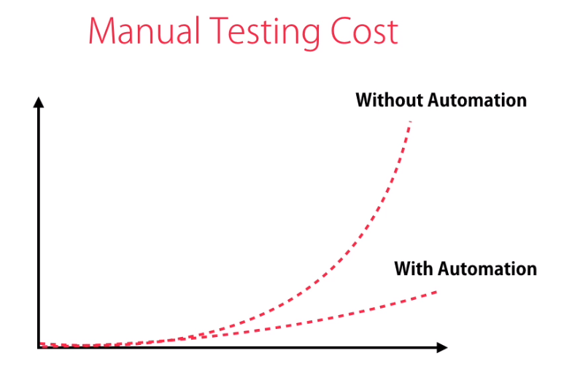
Automated Testing
Is a replacement for manual testing?
Do we really need it?
Notes:
Bugs and errors can be caught before release

Slide 90
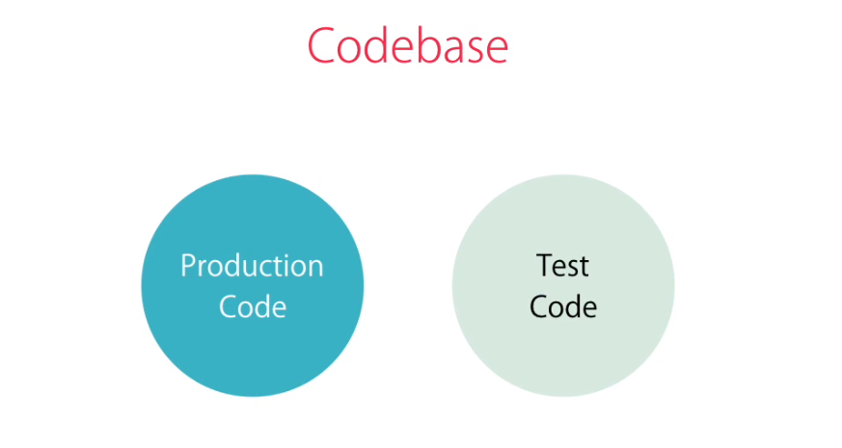
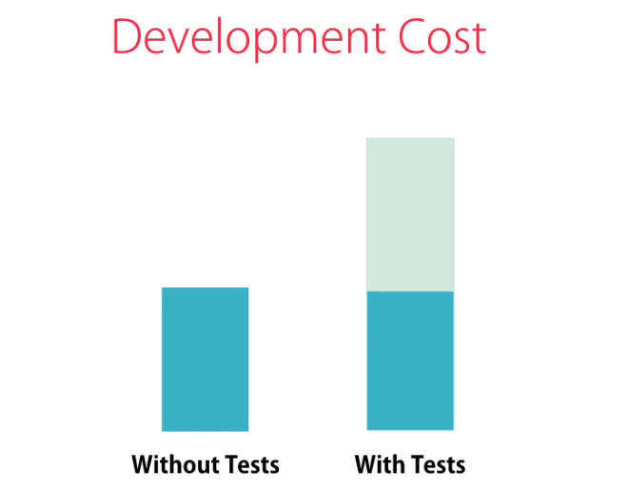
Development Cost

Slide 91
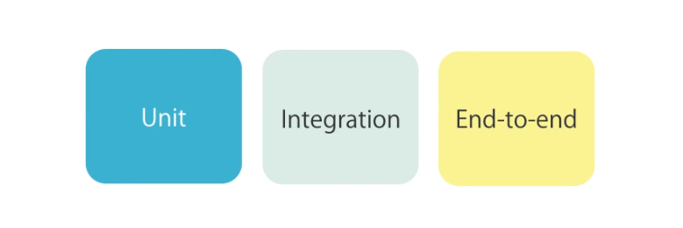
Types of Tests

Slide 92
Unit Test
Unit Test
Test a component in isolation without external resources e.g. file system, API end points and database.
Easiest to write, superfast.
But, they don’t give us much confidence about the functionality.
Small functions with maximum 10 line of code with proper naming and single responsible principle.
ng test
Notes:
If we forgot to write the binding to the function then until we run we can’t get to know thouth
We have unit tested successfully the function.

Slide 93
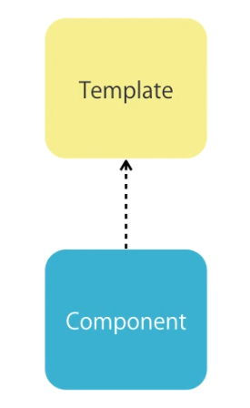
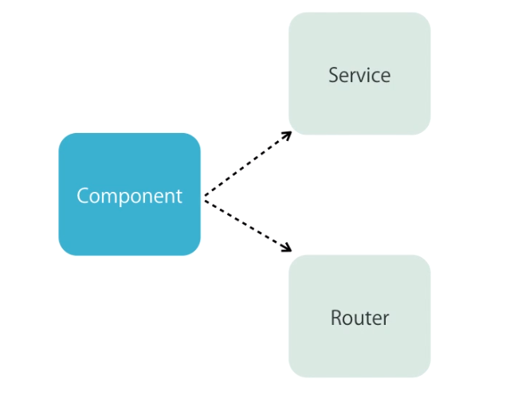
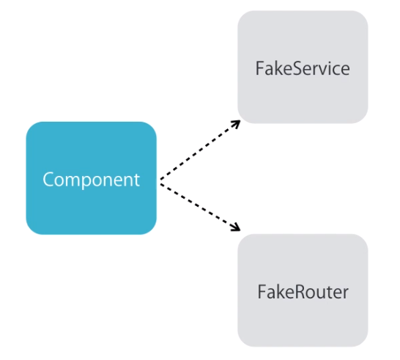
Unit Test with Angular
Notes:
Integration Test : component + template
Unit test : only component

Slide 94
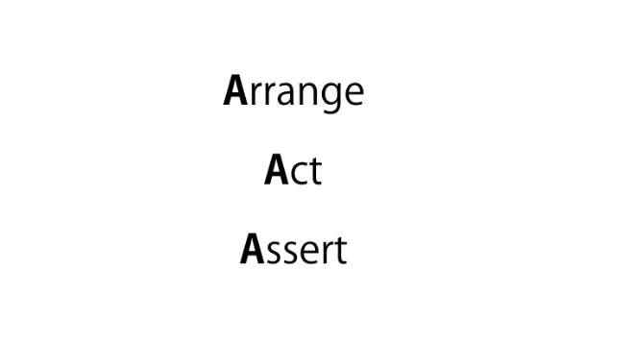
Unit Test Assertions
toBe()
toContain()
Notes:
Why beforeEach : Execution of one test can affect the execution of other test
In unit test remember, each and every test should run in an isolated as if this is the only test in the world.

Slide 95
Assertions
not.toBeNull()
and.callFake();

Slide 96
Integration Test
Testing templates
Testing navigations
Testing directives
Dealing with async operations

Slide 97
Setting up integration test
import { TestBed } from '@angular/core/testing';
TestBed
TestBed.configureTestingModule();
declarations
Fixture
detectChanges()

Slide 98
Quering To elements
fixture.debugElement.query(By.css(“.className”))
queryAll
By.directive – for custom directives
Notes:
When we use navigation in the different module
Then <app-nav></app-nav> is not a known element. Then use TestBedConfigurationModule.(
Schemas: [NO_ERRORS_SCHEMA]
)
NO_ERRORS_SCHEMA will tell anglar not to error when unknown element is found in the component

Slide 99
Attribute Directive Testing
We need to create HostComponent

Slide 100
Deployment

Slide 101
Optimize the application for deployment
Build deployable packages
Working with different environments
Lint your code

Slide 102
Preparing For Deployment
We can copy as is to server
But it has lots of unwanted files
See, the node_modules sizes around 230MB
Large bundle
Optimization Technique
Minification
Uglification : long function and variable names becomes short scripted names
Bundling
Dead code elimination
AOT compilation
Notes:
Ng – build prod

Slide 103

JIT
Just in time compilation : for the example above, angular will create div, then create h2 tag and insert the text in it, this is called “Just In Time compilation”
Drawbacks
Inefficient for production
Happens for every user
Performance slower
Vender bundle size increases
That’s why we moved to bundle concept.
Notes:
Js to js compilation
Only angular knows the meaning of {{ interpolation }}
Section12/lession135

Slide 104
AoT
Users will download the precompiled application, no need to compile code every time.
Faster startup
No required to provide the vender bundle, so it minimizes the size of the vendor bundle.
Catch the template errors earlier
Better security, because all html templates are turned into js before delivering to client

Slide 105
Angular in Action
package.json - > @angular/compiler-cli
Notes:
Node_modules/.bin/ngc
Will create
component.ngfactory.ts (which is the combination of HTML markup and typescript component)
With ng build we don’t have AOT compilation here, angular compiler is a part of vender bundle

Slide 106
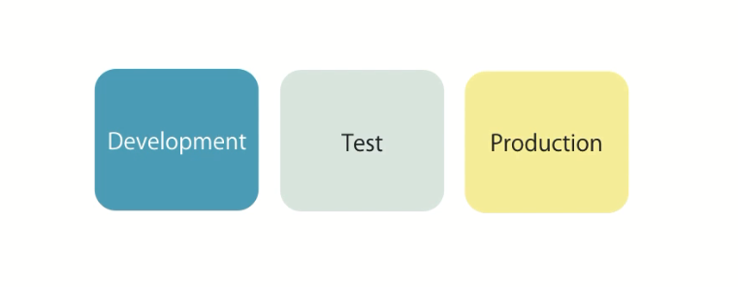
Environments
Notes:
When hit the page --→ component ngfactories are created
Angular cli will internally run the angular compiler
Ng serve –prod
Npm install –g angular-cli-ghpages (githubpages)
ngp
Ng build –prod –base-href=“/” && ngh ===== then run like npm run ng:deploy

Slide 107
Animation

Slide 108
Animations Module
trigger()
transition()
state()
animate()
Etc……

Slide 109
Material Design

Slide 110
Angular Material
Working with various components
Working with in built themes
Creating a custom theme
Angular material typography

Slide 111
What is Angular Material
A library of high quality UI components built with Angular and TypeScript.

